Slide 1
DevOps and Code Management

Slide 2

Software support
Traditionally, separate teams were responsible software development, software release and software support.
The original development team were sometimes also responsible for implementing software changes.
Alternatively, the software may have been maintained by a separate ‘maintenance team’.
user
Development Team
Release Team
Testing
Customer Support

Slide 3
Development, release and support
inevitable delays and overheads in the traditional support model.

Slide 4
DevOps: Development+Operations
To speed up the release and support processes, an alternative approach called DevOps has been developed.
Three factors led to the development and adoption of DevOps:
Agile methodology that reduced the development time
Amazon re-engineered their software around services
They suggested the same team develop and support each service
Amazon’s claim that this improves the reliability was widely publicized.
It became possible to release software as a service, running on a cloud.

Slide 5
DevOps

Slide 6
DevOps principles
Everyone is responsible for everything All team members have joint responsibility for developing, delivering and supporting the software.
Everything that can be automated should be automated
All activities involved in testing, deployment and support should be automated if it is possible to do so.
There should be minimal manual involvement in deploying software.
Measure first, change later DevOps should be driven by a measurement program where you collect data about the system and its operation. You then use the collected data to inform decisions about changing DevOps processes and tools.

Slide 7
Benefits of DevOps
Faster deployment
Software can be deployed to production more quickly because communication delays between the people involved in the process are dramatically reduced.
Reduced risk
The increment of functionality in each release is small so there is less chance of feature interactions causing failures and outages.
Faster repair
DevOps teams cooperate to get the software up and running again asap.
No need to wait and find the responsible team for the problem and waiting for them to fix it.
More productive teams
DevOps teams are happier and more productive than the teams involved in the separate activities.

Slide 8
Code management
During the software development, the team creates tens of thousands of lines of code and automated tests.
hundreds of code files, dozens of libraries, and several different programs that are involved in creating and running the code.
Code management is a set of software-supported practices that is used to manage an evolving codebase.
They ensure that changes made by different developers do not interfere with each other, and to create different product versions.
Code management tools make it easy to:
Create an executable product from its source code files
Run automated tests on that product.

Slide 9
Code management problem example
Alice and Bob worked for a company called FinanceMadeSimple and were team members involved in developing a personal finance product. Alice discovered a bug in a module called TaxReturnPreparation. The bug was that a tax return was reported as filed but, sometimes, it was not actually sent to the tax office. She edited the module to fix the bug. Bob was working on the user interface for the system and was also working on TaxReturnPreparation. Unfortunately, he took a copy before Alice had fixed the bug and, after making his changes, he saved the module. This overwrote Alice’s changes but she was not aware of this.
The product tests did not reveal the bug as it was an intermittent failure that depended on the sections of the tax return form that had been completed. The product was launched with the bug. For most users, everything worked OK. However, for a small number of users, their tax returns were not filed and they were fined by the revenue service. The subsequent investigation showed the software company was negligent. This was widely publicized and, as well as a fine from the tax authorities, users lost confidence in the software. Many switched to a rival product. FinanceMade Simple failed and both Bob and Alice lost their jobs.

Slide 10
Code management and DevOps
Source code management, combined with automated system building, is essential for professional software engineering.
In companies that use DevOps, a modern code management system is a fundamental requirement for ‘automating everything’.
Not only does it store the project code that is ultimately deployed, it also stores all other information that is used in DevOps processes.
DevOps automation and measurement tools all interact with the code management system

Slide 11
Code management and DevOps

Slide 12
Code management fundamentals
Code management systems provide features that support four areas:
Code transfer Developers take code into their personal file store to work on it then return it to the shared code management system.
Version storage and retrieval Files may be stored in several different versions and specific versions of these files can be retrieved.
Merging and branching Parallel development branches may be created for concurrent working. Changes made by developers in different branches may be merged.
Version information. Information about different versions maintained in the system may be stored and retrieved

Slide 13
Code repository
Source code management systems provide a shared repository and a set of features to manage the files in that repository:
All source code files and file versions are stored in the repository, as are other artifacts such as configuration files, build scripts, and shared libraries
Repository includes a database about the stored files: e.g., version information, who has changed the files, what changes were made at what times…
Files can be transferred to and from the repository and information about the different versions of files and their relationships may be updated.
Specific versions of files and information about these versions can always be retrieved from the repository

Slide 14
Features of code management systems
Version and release identification Managed versions of a code file are uniquely identified when they are submitted to the system and can be retrieved using their identifier and other file attributes.
Change history recording The reasons why changes to a code file have been made are recorded and maintained.
Independent development Several developers can work on the same code file at the same time. When this is submitted to the code management system, a new version is created so that files are never overwritten by later changes.
Storage management The code management system includes efficient storage mechanisms so that it doesn’t keep multiple copies of files that have only small differences.

Slide 15
Git
In 2005, Linus Torvalds, the developer of Linux, revolutionized source code management by developing a distributed version control system (DVCS) called Git to manage the code of the Linux kernel.
This was to manage open-source projects.
It took advantage of the fact that storage costs had fallen to such an extent that most users did not have to be concerned with local storage management.
Git maintains a clone of the repository on every user’s computer

Slide 16
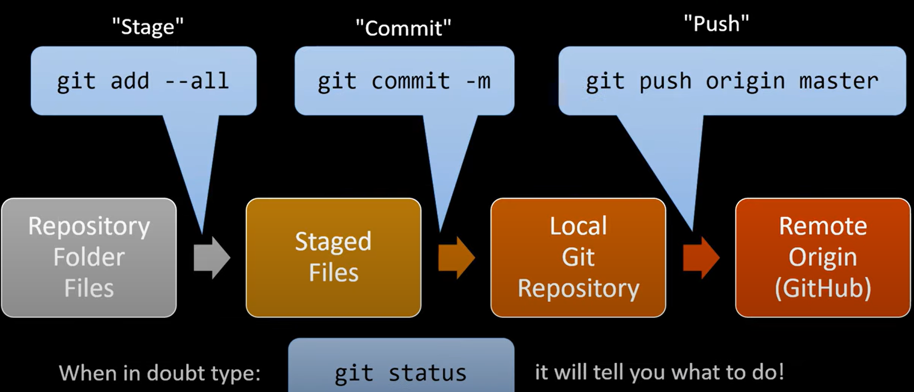
Git Basics
Git tutorial:
https://www.youtube.com/watch?v=xvwBtODV0ms

Slide 17
Repository cloning in Git

Slide 18
Benefits of distributed code management
Resilience
Everyone working on a project has their own copy of the repository. If the shared repository is damaged or subjected to a cyberattack, work can continue, and the clones can be used to restore the shared repository. People can work offline if they don’t have a network connection.
Speed
Committing changes to the repository is a fast, local operation and does not need data to be transferred over the network.
Flexibility (local experimentation global deployment)
Developers can safely experiment and try different approaches without exposing these to other project members. With a centralized system, this may only be possible by working outside the code management system.

Slide 19
Git repositories

Slide 20
Branching and merging
Branching and merging are fundamental ideas that are supported by all code management systems.
Branch: is an independent, stand-alone version that is created when a developer wishes to change a file (isolated line of development).
The changes made by developers in their own branches may be merged to create a new shared branch.
The repository ensures that branch files that have been changed cannot overwrite repository files without a merge operation.
If Alice or Bob make mistakes on the branch they are working on, they can easily revert to the master file.
If they commit changes, while working, they can revert to earlier versions of the work they have done. When they have finished and tested their code, they can then replace the master file by merging the work they have done with the master branch

Slide 21
Branching and merging
Forks vs branch in Git (Github)?

Slide 22
DevOps+automation
Everything that can be, should be automated is a fundamental principle of DevOps.
By using DevOps with automated support, you can
reduce the time and costs for integration, deployment, and delivery.
makes integration, deployment and delivery more reliable and reproducible.
Automation information is encoded in scripts that can be checked, reviewed, versioned and stored in the project repository.

Slide 23
What does DevOps automation mean?
Continuous integration Upon committing a change to the master branch, an executable system is built
This includes “building”, “running”, “adding artifacts”, and "integration tests”
Continuous delivery A pre-production environment is created and the executable software version is tested by the quality assurance team.
Continuous deployment A new release of the system is made available to users every time a change is made to the master branch of the software.
Infrastructure as code
Machine-readable scripts to configure infrastructure (network, servers, routers, etc.) for the produced software.
The scripts also include installing and configuring software tools (compilers, libraries, DBMS).

Slide 24
System integration (system building)
System integration is the process of gathering all the elements required in a working system and putting them together to create an operational system.
Typical activities that are part of the system integration process include:
Installing database software and setting up the database with the appropriate schema.
Loading test data into the database.
Compiling the files that make up the product
Linking the compiled code with the libraries and other components used.
Checking that external services used are operational.
Deleting old configuration files and moving configuration files to the correct locations.
Running a set of system tests to check that the integration has been successful.
Examples of integration tools: Make, Ant (for Java), Maven, Yaml files, etc.

Slide 25
Continuous integration (CI)
Continuous integration means that an integrated version of the system is created and tested every time a change is pushed to the repository.
Upon completion of the push operation, the repository sends a message to an integration server to build a new version of the product
The advantage of continuous integration (compared to infrequent integration) is faster finding and fixing bugs
If you make a small change and some system tests then fail, the problem almost certainly lies in the new code that is pushed to the repo!
You can focus on this code to find the bug causing the problem.

Slide 26
Continuous integration (e.g., via Azure DevOps)

Slide 27
“Don’t break the build!”
Breaking the build means pushing code to the project repository which, when integrated, causes some of the system tests to fail.
In a CI, developers have to make sure that they don’t ‘break the build’.
If this happens, you should discover and fix the problem so that normal development can continue.
How to avoid breaking the build?
Practice ‘integrate twice’ approach
You should integrate and test on your own computer before pushing code to the project repository to trigger the integration server

Slide 28
First do the “local integration”

Slide 29
System building
CI is only effective if the integration process is fast and developers do not have to wait for the results of their tests of the integrated system.
However, some activities in the build process, such as populating a database or compiling hundreds of system files, are inherently slow.
It is essential to have an automated build process that minimizes the time spent on these activities.
Fast system building is achieved using a process of incremental building, where only those parts of the system that have been changed are rebuilt

Slide 30
Dependencies
Figure 1 is a dependency model that shows the dependencies for test execution.
The upward-pointing shows the information required to complete the task shown in the rectangle
Running system tests depends on the existence of executable object code for the program and system tests
Figure 2: a lower-level dependency model that shows the dependencies involved in creating the object code for a source code files, called Mycode.

Slide 31
Automated build systems
An automated build system uses the specification of dependencies to work out what needs to be done.
It uses the file modification timestamp to decide if a source code file has been changed.
The modification date of the compiled code is after the modification date of the source code.
The build system infers that no changes have been made to the source code and does nothing.
The modification date of the compiled code is before the modification date of the compiled code.
The build system recompiles the source and replaces the existing file of compiled code with an updated version.
The modification date of the compiled code is after the modification date of the source code. However, the modification date of Classdef is after the modification date of the source code of Mycode.
Therefore, Mycode has to be recompiled to incorporate these changes.

Slide 32
Continuous delivery vs deployment
Continuous integration means creating an executable version of a software system whenever a change is made to the repository.
The CI tool builds the system and runs tests on your development computer or project integration server.
However, the real environment in which software runs will inevitably be different from your development system.
When your software runs in the operational environment bugs may be revealed that did not show up in the test environment.
Continuous delivery means that, after making changes to a system, you ensure that the changed system is ready for delivery to customers.
You have to test it in a production environment to assure environmental factors do not cause failures or slow down

Slide 33
Continuous delivery and deployment

Slide 34
The deployment pipeline
After initial integration testing, a staged test environment is created.
This is a replica of the actual production environment where the system will run.
System acceptance tests, including functionality, load and performance tests, are done to check that the software works as expected.
Once all tests pass, the updated version is installed on the production servers.
To deploy the system:
Momentarily stop all new requests for service and leave the older version to process the outstanding transactions.
Once these complete, switch to the new version and restart processing.

Slide 35
Benefits of continuous deployment (CD)
Reduced costs If you use CD, you have no option but to invest in an automated deployment pipeline.
Manual deployment is time-consuming and error-prone.
Setting up an automated system is expensive and time-consuming, but you can recover these costs quickly if you make regular updates to your product.
Faster problem solving
If a problem occurs, it only affect a small part of system and it is easy to debug
If you bundle many changes into a single release, finding and fixing problems is more difficult.
Faster customer feedback
You can ask users for feedback and identify improvements that you need to make
A/B testing
This is an option if you have a large customer base and use several servers for deployment
Deploy a new version of the software on some servers and older version running on others.
Use load balancer to divert some customers to the new version and some to the older version.
You can then measure and assess how new features are used to see if they do what you expect.

Slide 36
Infrastructure as code
In an enterprise environment, there are different physical or virtual servers (web servers, database servers, file servers, etc.)
These have different configurations and run different software packages
It is difficult to keep track of the software installed on each machine
Infrastructure as code proposed as a way to address this problem. Rather than manually updating the software on a company’s servers, the process can be automated using a model of the infrastructure written in a machine-processable language.
Configuration management (CM) tools (e.g., Puppet and Chef) can automatically install software and services on servers according to the infrastructure definition
The benefits of infrastructure as code are lower costs of system management and lower risks of unexpected problems

Slide 37
Infrastructure as code

Slide 38
Characteristics of infrastructure as code
Visibility Your infrastructure is defined as a stand-alone model that can be read, discussed, understood and reviewed by the whole DevOps team.
Reproducability
Using a configuration management tool the installation tasks will always be run in the same sequence → the same environment is always created.
You are not reliant on people remembering the order that they need to do things.
Reliability System admins often make simple mistakes, especially when the same changes have to be made to several servers. Automating the process avoids these mistakes.
Recovery
Like any other code, your infrastructure model can be versioned and stored in a code management system.
If infrastructure changes cause problems, you can revert to an older version and reinstall the environment that you know works.

Slide 39
Containers
A container provides a stand-alone execution environment running on top of an operating system such as Linux.
The software installed in a Docker container is specified using a Dockerfile, which is, essentially, a definition of your software infrastructure as code.
You build an executable container image by processing the Dockerfile.
Using containers makes it very simple to provide identical execution environments.
For each type of server that you use, you define the environment that you need and build an image for execution.
You can run an application container as a test system or as an operational system; there is no distinction between them.
When you update your software, you rerun the image creation process to create a new image that includes the modified software.
You can then start these images alongside the existing system and divert service requests to them.

Slide 40
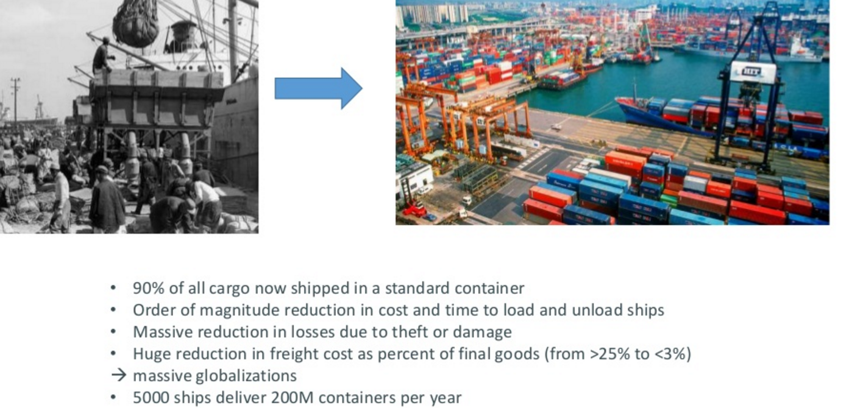
Container Nomenclature

Slide 41
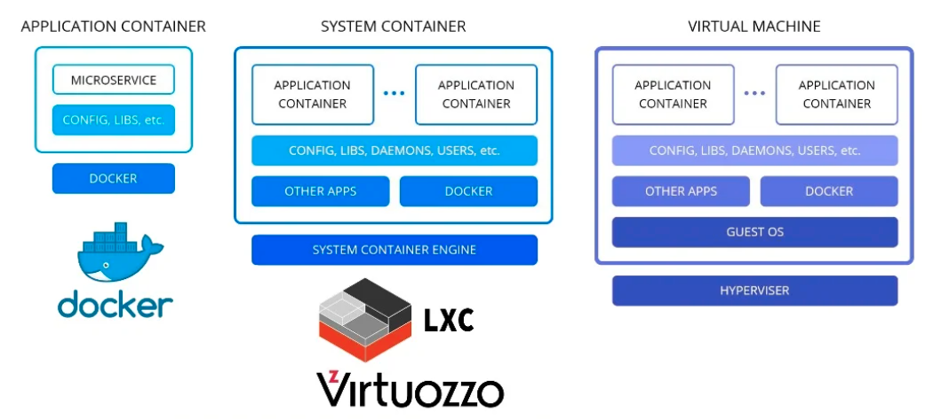
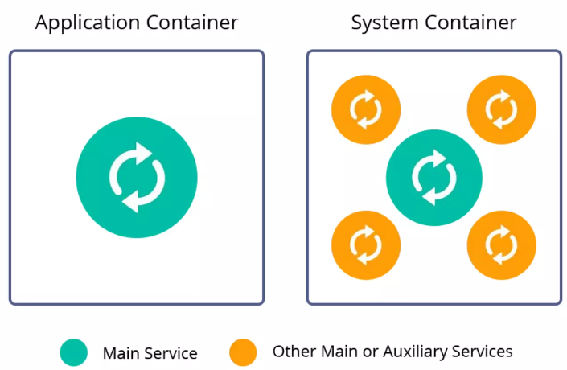
Various Container Technologies
Container technologies:
Application container
Ex: Docker, Podman, Singularity.
System container
LXC and OpenVZ (developed by Virtuozzo)
Image source: https://www.slideshare.net/jelastic/kubernetes-and-nested-containers-enhanced-3-ps-performance-price-and-provisioning

Slide 42

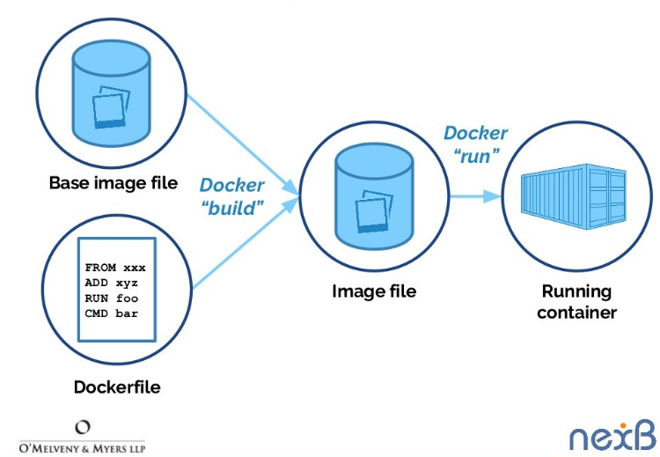
Docker File, Image, Hub, Instance, and Volume
A container is stateless by default, but can be attached a "volume" for persistence

Slide 43
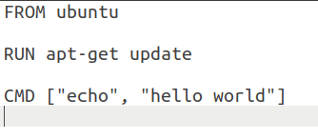
Docker File: An Example
A script that automates docker image creation
It instructs Docker how to build an image
Below: A Hello World example on an ubuntu base image
Test: docker images
Test: docker run image-name
Receives base image from Docker hub if not available locally
Adds this (or other) packages to the image
Runs this command on the container instance
(docker run)

Slide 44
DevOps measurement
You should try to continuously improve your DevOps process to achieve faster deployment of better-quality software.
There are four types of software development measurement:
Process measurement You collect and analyze data about your development, testing and deployment processes.
Service measurement You collect and analyze data about the software’s performance, reliability and acceptability to customers.
Usage measurement You collect and analyze data about how customers use your product.
Business success measurement You collect and analyze data about how your product contributes to the overall success of the business.

Slide 45
Automating measurement!
You should instrument your software to collect data about itself
You can also use a monitoring system, to collect data about your software’s performance and availability.
e.g., Prometheus or Datadog
Some process measurements can also be automated.
However, there are problems in process measurement because people are involved. They work in different ways, may record information differently and their performance varies over time.

Slide 46
Metrics used in the DevOps scorecard

Slide 47
Metrics scorecard
Payal Chakravarty from IBM suggests a practical approach to DevOps measurement based around a metrics scorecard with 9 metrics:
These are relevant to software that is delivered as a cloud service. They include process metrics and service metrics
For the process metrics,
You would like to see decreases in:
Number of failed deployments
Mean time to recovery after a service failure
Lead time from development to deployment.
You would hope to see increases
deployment frequency
number of lines of changed code (change volume) that are shipped.
For the service metrics: availability and performance should be stable or improving; the number of customer complaints should be decreasing, and the number of new customers should be increasing.

Slide 48
Devops metrics trends (needed in your final report):

Slide 49
Logging and analysis

Slide 50
Key points 1
DevOps is the integration of software development and the management of that software once it has been deployed for use. The same team is responsible for development, deployment and software support.
The benefits of DevOps are faster deployment, reduced risk, faster repair of buggy code and more productive teams.
Source code management is essential to avoid changes made by different developers interfering with each other.
All code management systems are based around a shared code repository with a set of features that support code transfer, version storage and retrieval, branching and merging and maintaining version information.
Git is a distributed code management system that is the most widely used system for software product development. Each developer works with their own copy of the repository which may be merged with the shared project repository.

Slide 51
Key points 2
Continuous integration means that as soon as a change is committed to a project repository, it is integrated with existing code and a new version of the system is created for testing.
Automated system building tools reduce the time needed to compile and integrate the system by only recompiling those components and their dependents that have changed.
Continuous deployment means that as soon as a change is made, the deployed version of the system is automatically updated. This is only possible when the software product is delivered as a cloud-based service.
Infrastructure as code means that the infrastructure (network, installed software, etc.) on which software executes is defined as a machine-readable model. Automated tools, such as Chef and Puppet, can provision servers based on the infrastructure model.
Measurement is a fundamental principle of DevOps. You may make both process and product measurements. Important process metrics are deployment frequency, percentage of failed deployments, and mean time to recovery from failure.

